Slide 1
Construal of a person in Arapaho complaints
Irina Wagner PhD Student University of Colorado Boulder Department of Linguistics

Slide 2


Acknowledgements
Northern Arapaho Language and Culture Commission
Dr. Andrew Cowell (University of Colorado Boulder)
Dr. Barbara Fox (University of Colorado Boulder)
The Department of Linguistics (University of Colorado Boulder)
Center of Studying Indigenous Languages of the West
University of Colorado’s United Government of Graduate Students.

Slide 3
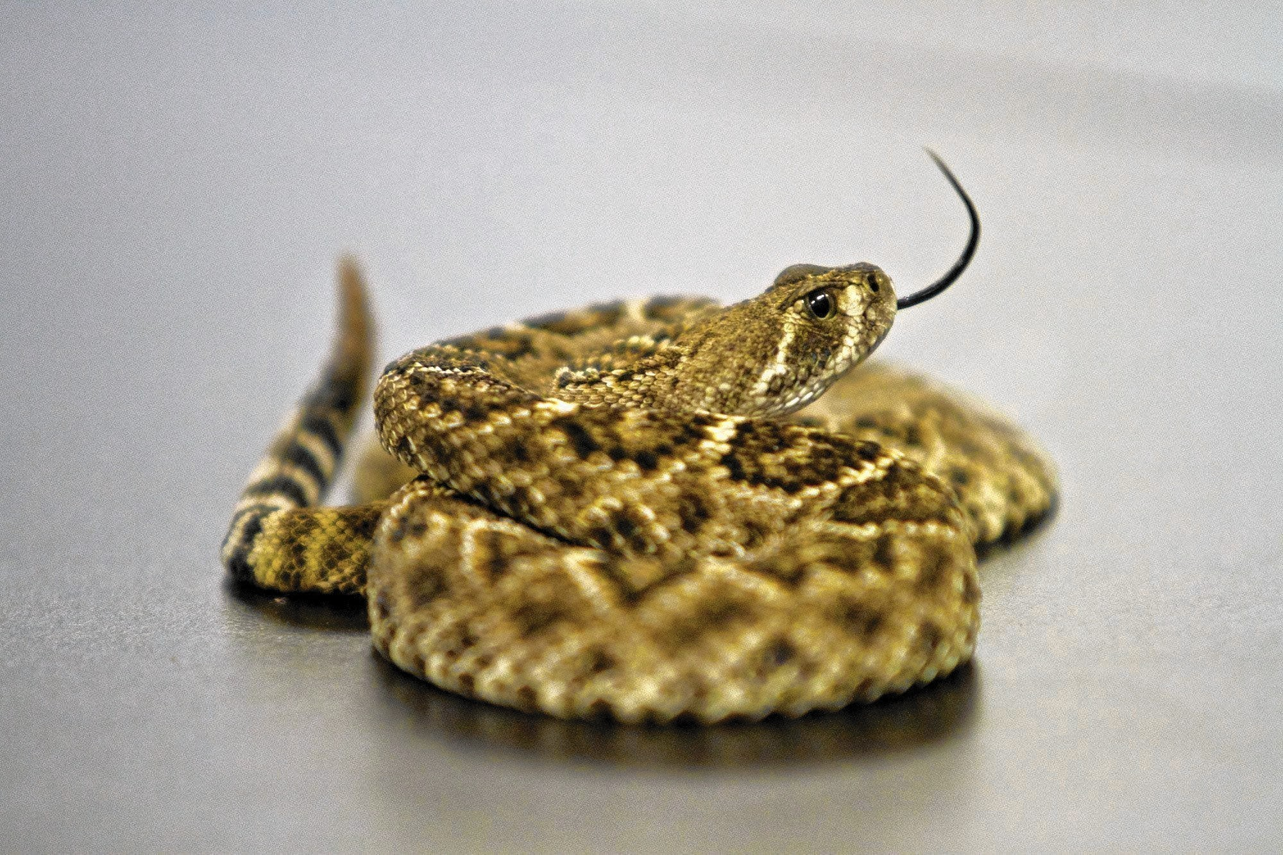

Gossiping in Arapaho culture

Slide 4
The background of the study
Preliminary research on person reference terms shows slight deviations from the basic principles (Sacks & Schegloff 1979).
Preference for kin terms is more significant.
Dependence on the projected action & on the thematic domain:
Praise & positive assertions trigger kin terminology;
Sense of cultural pride evokes traditional Arapaho names;
English names are mainly used in work-related environments;
Complaints never include names and steer towards the “longer” terms of reference, e.g., relative clauses.

Slide 5
Theoretical background
Speakers rely on structural (1) and cultural (2) premises in formulation of reference:
(1) principles of minimization and recognition (Sacks & Schegloff, 1979), relevant role (De Fornel, 1987)
(1) reference can negotiate conversational structure (Schegloff, 1996; Fox, 1984),
(1) reference often aligns with conversational action (Stivers, 2007)
(2) circumspection (Levinson, 2007)
(2) association (Brown, 2007)

Slide 6
In general, communities of practice prioritize some principles over others in formulation of reference according to the salient features of person identification (Enfield, 2007).

Slide 7
Main question
What are the strategies for identity construal in complaints:
What are the linguistic devices helping to construct reference?
How is vagueness rendered in identifying a person?
How is ambiguity avoided?
How such terms of reference are understood by the addressees?

Slide 8
Data
Endangered Languages and Documentation Program grant to record naturally occurring conversations in Arapaho (2008-2010)
Data recorded, transcribed, and translated by the Center of Indigenous Languages of the West at the University of Colorado Boulder.
Data available in Endangered Languages Archive.

Slide 9
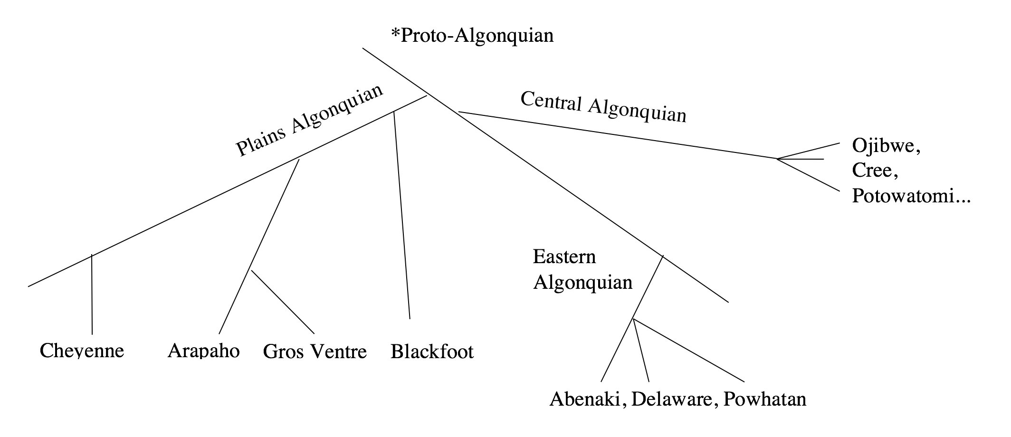
Arapaho

Slide 10
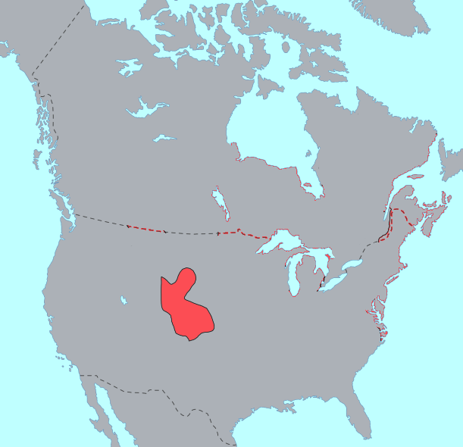
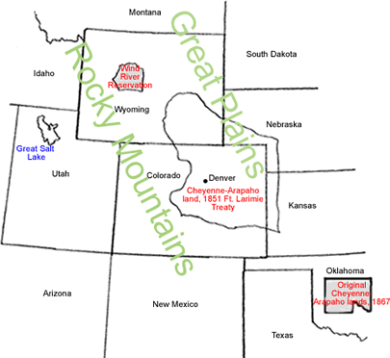
Arapaho
Wind River Indian Reservation
Wyoming, USA
< 5,000 enrolled
<100 native fluent speakers

Slide 11
Linguistic note
Poly-synthetic agglutinating language
NP’s are infrequent
Most references can be done with verbal inflections
References can also be done by:
Names (Anglo, Arapaho)
NP (membership categorization)
Relative Clause (descriptor, membership categorization)
Determiners (anaphoric)
Pronominal elements (anaphoric)
Verbs (anaphoric)
Inflections (anaphoric)

Slide 12
Complaint problem
Multi-turn & multi-speaker engagement.
“complaints cannot simply be defined as particular expressions of discontent that are produced unilaterally by one of the participants” (Heinemann, 2009, p. 2382)
Don’t always exhibit marked expressions.

Slide 13
Methodology
Used 5 hours of naturally-occurring conversations about people.
Complaints were extracted on the base of negative assertions and response (agreement/disagreement/sympathy) of the addressee.
Total of 12 complaints about third party.
The form of person reference is recorded, also recorded previous mention of same person, if any.

Slide 14
Types of Person References
Targeted individuals:
Specific unnamed people deduced from the context of talk.
Targeted “others”:
Named group of people to whom neither of the speakers belong.
Everyone in the community:
Generalized people of the whole community based.

Slide 15
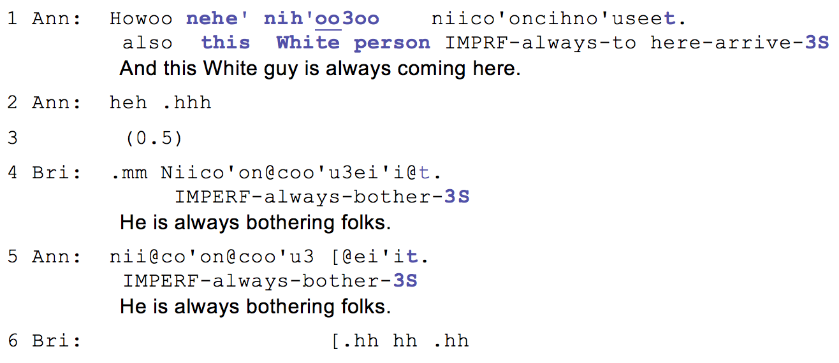
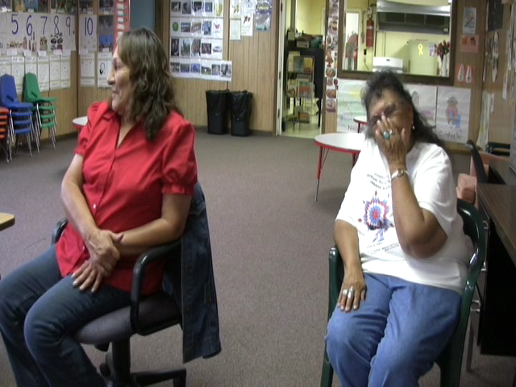
Targeted individuals
Example (1). 47a (04:01-04:07)
Notes:
In example 1, the referent is present in the context of the recording – the graduate student doing this recording was introduced to the speakers by him. He speaks the language fluently and the speakers know him well by name, either traditional or the Anglo.
Vera begins a new sequence of a complaint by attributing it to the researher. In line 1, she refers to him with a noun phrase “Nehe’ Nih’oo3oo” this white man (trickster). She boosts her complaint by adding a prefix co’on- “always” which is picked up by Iris in the second position with agreeing addition. Importantly, the speakers do not provide any additional identifying information about the researcher, neither do they use pointing to disambiguate his identity. In fact, his identity seems to be hidden from other participants, notably researcher himself, and it is largely deduced from the context of a conversation. After the initial introduction of the referent in line 1, both of the interlocutors resort to anaphoric personal inflection eventually turning the complaint into a joke.

Slide 16

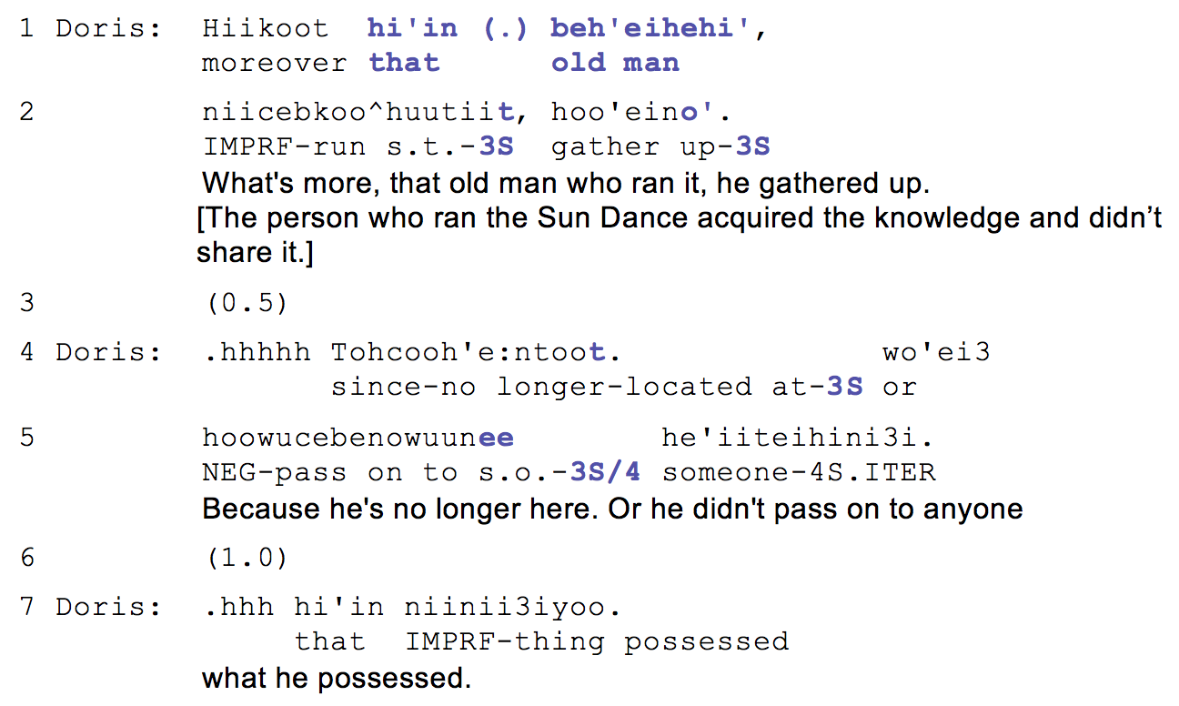
Targeted individuals
Example (2). 21b (06:50-07:00).
Notes:
This example is taken from a conversation between husband and wife. In this part, they are discussing the loss of culture in their community. They attribute its loss to the elders who are unwilling to share their knowledge with the rest of the people.
The target reference is in line 1. Note that neither of the speakers have mentioned the particular elder prior to this turn. Yet, the speaker formulates the reference using the demonstrative pronoun hi’in which intrinsically suggests “aforementioned.” To identify the referent, the speaker uses a descriptive noun phrase that can be loosely translated as “the old man who ran Sun Dance.” The status of the referent is highly privileged – the person who runs Sun Dance is elected by elders of the community for several years. So, Doris’s complaint is potentially problematic because it can be seen as undermining that man’s authority. Using a vague reference here though allows her to hold on to her own dignity without openly criticizing the man, but at the same time it creates enough reference for her husband to understand who she’s talking about without forming a repair in the following sequence.

Slide 17
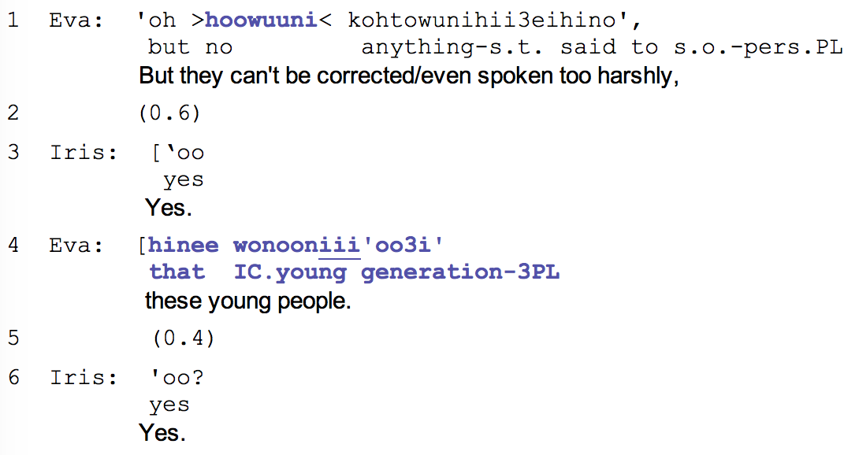
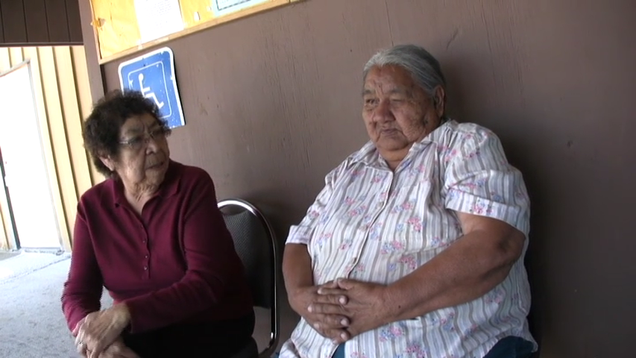
Targeted “others”
Example (3). 35b (10:06-10:23)
Notes:
The previous examples demonstrated the use of noun phrases and 3S inflectional marker to construct a reference to a particular person without overtly naming him or her. Often our data demonstrates complaints about a category of people our speakers do not belong to, or “others.” Such groups as “the youth,” “the white people,” “the students,” etc. often become the objects of many complaints. Importantly, these groups are not by any means fully identified. So speakers do not really have a particular person of the group in mind, or are they certain of the misdoings of this group.
The form of person reference for “others” is either a relative clause or a full noun phrase followed by 3PL inflection. Example (3) comes from a conversation of two good friends sitting outside of an immersion school. This conversation was already underway when the researcher set up the camera. The women haven’t seen each other in a long time and have a lot to discuss. In this excerpt they are discussing the bad manners of the youth and their reluctance to learn the traditional language and culture.
The target person reference comes in line 4 following the negative detached prefix hoowuuni. The person reference is formed by a verb “be young” and a determiner, turning it into a relative clause. Neither of the referents have a particular person or a set of people in mind while making this complaint, at the same time, this reference form provides enough information for the addressee to know that it is a general complaint and eventually affiliate with it.

Slide 18
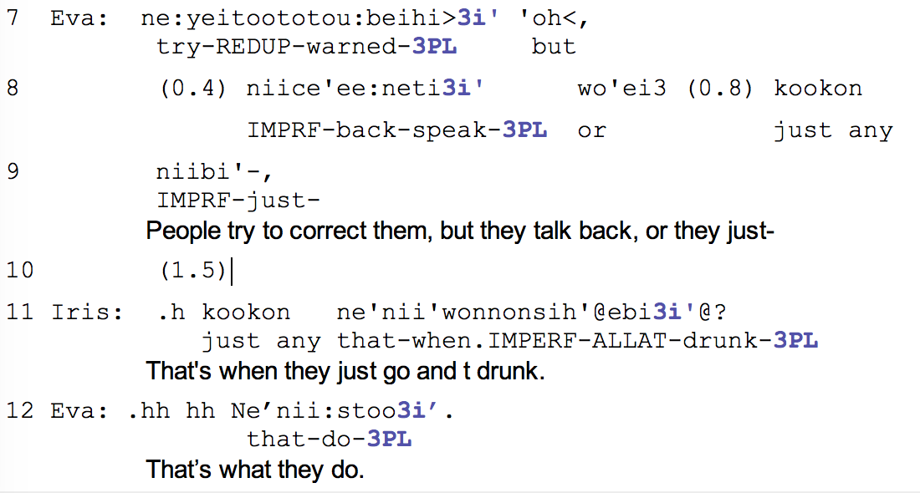
Targeted “others”
Example (3). 35b (10:06-10:23)
Notes:
The affiliation with this complaint is explicit in line 11, when Iris picks up and upgrades this complaint, referring to the youth with an anaphoric 3pl inflection.

Slide 19
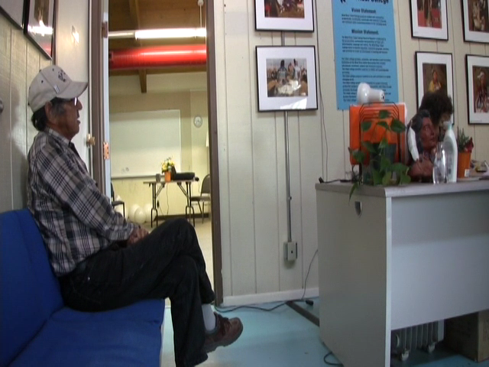
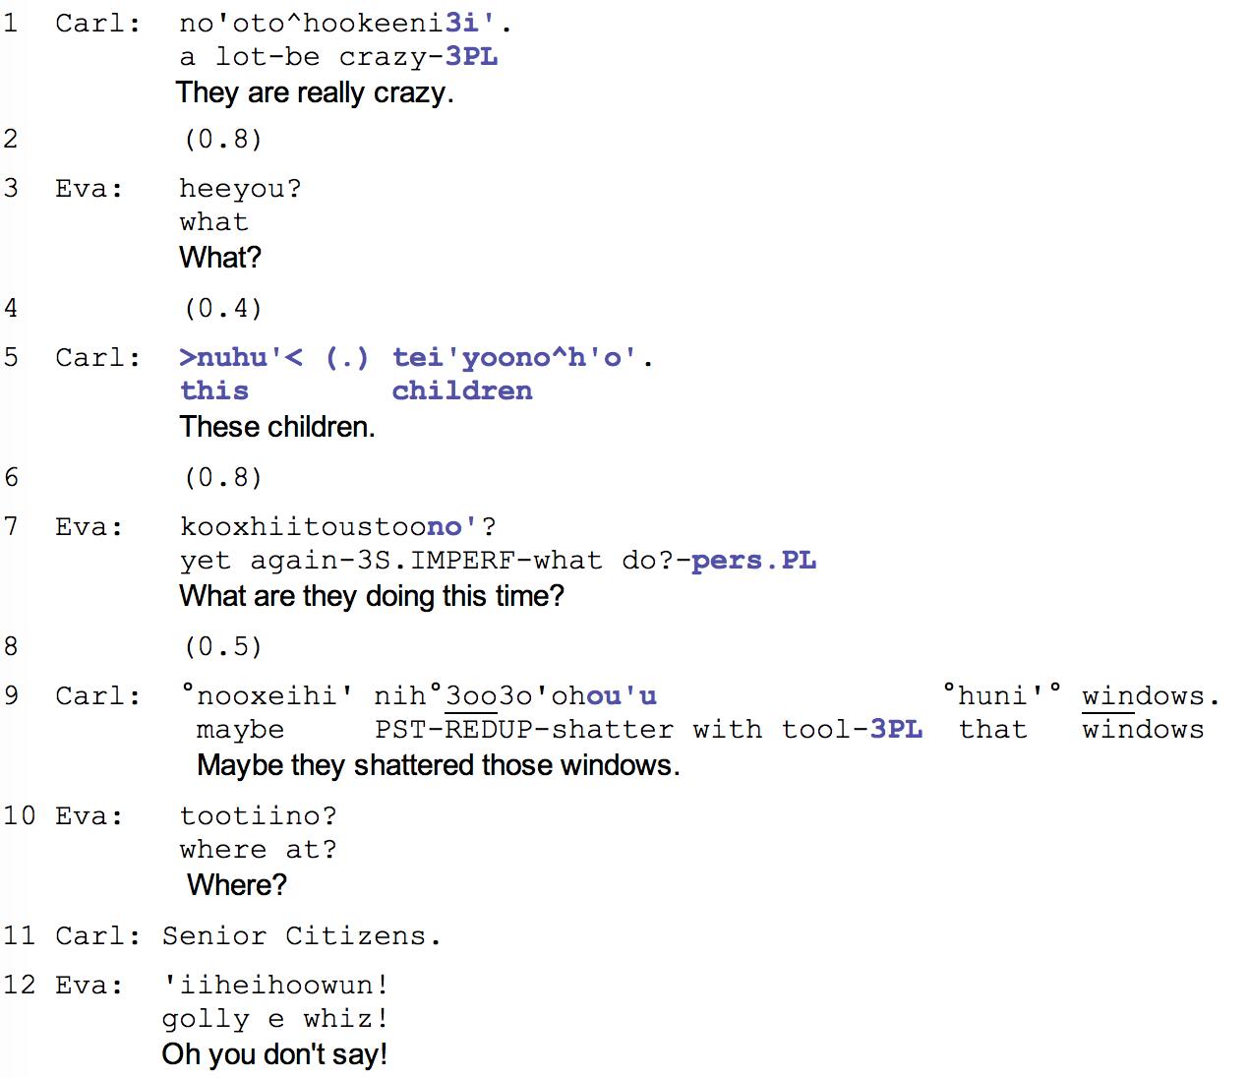
Targeted “others”
Example (4). Data 46a.
Notes:
Excerpt 4 is another example of a complaint against the youth. In this part of the video, Carl initiates a new topic in line 1 after a long pause. You can see that Eva is somewhat reluctant in picking it up, perhaps, because she does not know where Carl is going with this. The first attempt at referring to the kids with a 3pl inflection in line 1 is insufficient, as it prompts a repair from Eva, and now Carl has to explain what he means by it. The repair in line 5, which is a full noun phrase reference is not just sufficient, Eva indicates that she is aware of some general problems with the group, and now inquires what else they have done. Her agreement with the complaint in line 12 further demonstrates her thorough understanding and concern about these people.
In the last two examples we have observed a construal of identity for a group of others, who can not be fully identified due to the lack of speakers knowledge, yet, the information provided in a relative clause and the noun phrase in both examples shows to be sufficient for the addressee to align with the speaker and uptake the complaint.

Slide 20
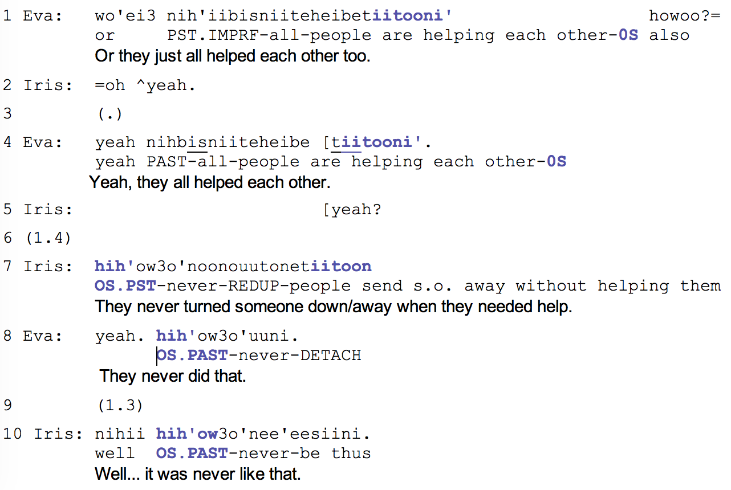
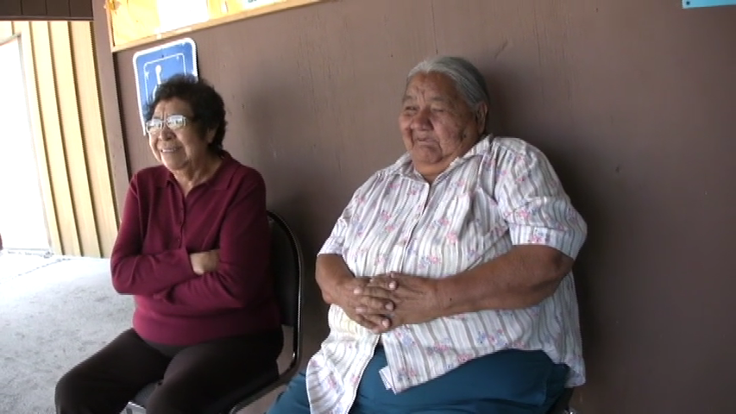
Everyone
Example (5). Data 35b (00:08-00:22).
Notes:
The last excerpt that I have prepared for you today demonstrates an impersonal complaint – a complaint that could be attributed to everybody in the community, including the speakers themselves.
In lines 1, 4, & 7 we see the complaint itself, but there is no personal inflection following it. Speakers here are using the impersonal verb form that changes animacy of the agent to inanimate to indicate that this type of behavior is seen overwhelmengly and cannot be attributed to a single person. Using this impersonal form allows speakers to eliminate the need to identify a referent and distribute the agency across the whole community. In fact, there is nothing in the verb or the inflection that could indicate the presence of agency. It is a useful device for speakers who also recognize their own behavior as problematic as it allows to avoid claiming responsibility for it.
In general, the person reference marked by this form, iitoon or iitooni is so vague that cannot be attributed to a person, group, or anyone. The vagueness though is not challenged by the addressee – in fact it is uptaken in the full agreement and repetition of the inflection.

Slide 21
Conclusion
Full singular NP form for complaining about individuals
No names or unique descriptors
Deducible from the context
Relative Clause or NP with 3PL inflections
For complaining about another group of people
No names, but RLCL provides enough info
These referents are not known to speakers
Impersonal forms to complain about community
Depersonalizes the main offender
Lifts responsibility
Requires no solution of a complained matter
Notes:
1)Reference for Targeted individuals is formed by a full NP: noun + determiner. Any following mention of the person is restricted to anaphoric verbal inflections, such as 3s. Importantly, when such form of reference is used, the identity of the individual is gathered from the previous context of the talk and it is only vaguely attributed by this NP not to cause any damage to the self representation of a person who doesn’t gossip.

Slide 22
References
Brown, P. (2007). Principles of person reference in Tzeltal conversations. In N. J. Enfield & T. Stivers (Eds.), Person reference in interaction: Linguistic, cultural, and social perspectives. (pp. 172–202). Cambridge, New York, Melbourne, Madrid, Cape Town, Singapore, Sao Paulo: Cambridge University Press.
de Fornel, M. (1987). Reference to persons in conversation. In J. Verschueren & M. Bertucelli-Papi (Eds.), The Pragmatic Perspective: Selected Papers from the 1985 International Pragmatics Conference (pp. 131–140). Amsterdam/Philadelphia: John Benjamins Publishing Company.
Enfield, N. J. (2007). Meanings of the unmarked: How “default” person reference does more than just refer, 97–120.
Fox, B. A. (1987). Anaphora in conversational English. In Anaphora and the structure of discourse (pp. 16–75). Cambridge: Cambridge University Press.
Heinemann, T. (2009). Participation and exclusion in third party complaints. Journal of Pragmatics, 41(12), 2435–2451. https://doi.org/10.1016/j.pragma.2008.09.044
Levinson, S. C. (2007). Optimizing person reference - perspectives from usage on Rossel Island. In N. J. Enfield & T. Stivers (Eds.), Person reference in interaction: Linguistic, cultural and social perspectives (pp. 29–72). Cambridge, New York, Melbourne, Madrid, Cape Town, Singapore, Sao Paulo: Cambridge University Press.
Sacks, H., & Schegloff, E. A. (2007). Two preferences in the organization of reference to persons in conversation and their interaction. In N. J. Enfield & T. Stivers (Eds.), Person Reference in Interaction: Linguistic, Cultural and Social Perspectives (pp. 23–28). Cambridge, New York, Melbourne, Madrid, Cape Town, Singapore, Sao Paulo: Cambridge University Press.
Schegloff, E. A. (1996). Some Practices for Referring to Persons in Talk-in-Interaction: Partial Sketch of a Systematics. In B. A. Fox (Ed.), Studies in Anaphora.
Stivers, T. (2007). Alternative recognitionals in person reference. In N. J. Enfield & T. Stivers (Eds.), Person Reference in Interaction: Linguistic, Cultural and Social Perspectives (pp. 73–96). Cambridge, New York, Melbourne, Madrid, Cape Town, Singapore, Sao Paulo: Cambridge University Press.

Slide 23
Go raibh maith agat!
Hohou!
Thank you!
Спасибо!
Kiitos!
Notes:
Gu rev ma agut

